Slide 1
CSE 440
Artificial Intelligence
Adversarial Search
Dr. Mohammad Mahmudul Alam
Department of Electrical & Computer Engineering (ECE)
North South University (NSU)

Slide 2
Last Time
Search: process of constructing sequences of actions that achieve a goal given a problem.
Uninformed search does not use any information about the goal direction, e.g., DFS, BFS, UCS.
Informed search utilized problem specific knowledge to make the search more efficient, e.g., Greedy Search, A*.
Local search only cares about the final state, not the path to get there, e.g., Hill-climbing search, Simulated Annealing.
The previous methods only examined single agents where the agent explored the search space by itself.

Slide 3
Adversarial Search
So far, in problem solving, we have examined single-agent search:
  The machine is “exploring” the search space by itself.
  No opponents or collaborators.
Games require generally multi-agent (MA) environments:
  Any given agent need to consider the actions of the other agent and to know how do they affect its success?
  Distinction should be made between cooperative and competitive MA environments.
  Competitive environments: give rise to adversarial search (playing a game with an opponent).

Slide 4
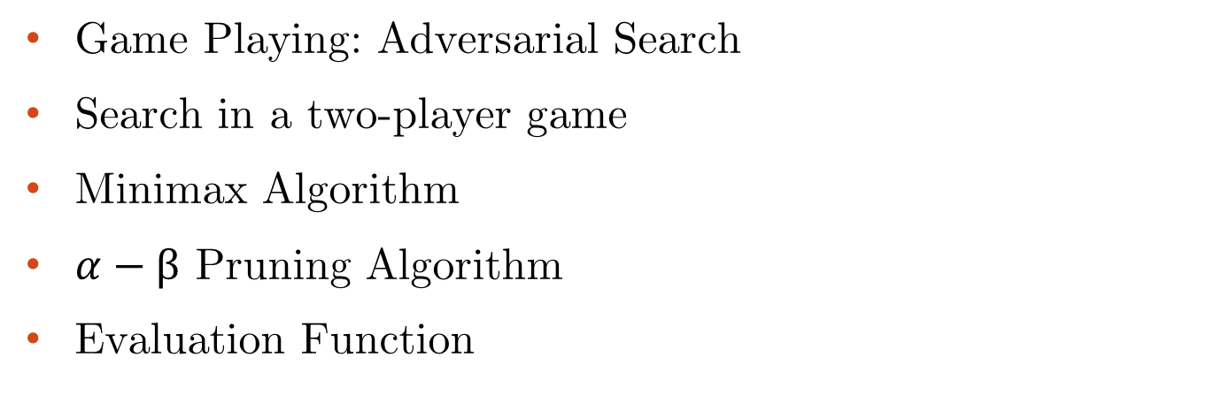
Adversarial Search: Outline
Game Playing: Adversarial Search
Search in a two-player game
Minimax Algorithm
$α−β$ Pruning Algorithm
Evaluation Function

Slide 5


Adversarial Search
Why study games?
Game playing is fun and is also an interesting meeting point for human and computational intelligence.
They are hard.
Easy to represent.
Agents are restricted to small number of actions.
Interesting question:
Does winning a game absolutely require human intelligence?

Slide 6



Adversarial Search
Different kinds of games:
 | Deterministic | Chance
Perfect Information | Chess, Checkers Go, Othello | Backgammon, Monopoly
Imperfect Information | Battleship | Bridge, Poker, Scrabble,
Games with perfect information (fully observable). No randomness is involved.
Games with imperfect information (players do not have complete knowledge about the state of the game). Random factors are part of the game.

Slide 7




Searching in a two-player game
Traditional (single-agent) search methods only consider how close the agent is to the goal state (e.g., best first search).
In two player games, decisions of both agents must be considered: a decision made by one agent will affect the resulting search space that the other agent would need to explore.
Question: Do we have randomness here since the decision made by the opponent is NOT known in advance?
☺ No. Not if all the moves or choices that the opponent can make are finite and can be known in advance.

Slide 8



Searching in a two-player game
To formalize a two-player game as a search problem, we call our two players MAX and MIN, MAX moves first, and then opponent MIN takes turn.
Problem Formulation:
Initial state: board configurations and the player to move.
Successor function: list of pairs (move, state) specifying legal moves and their resulting states. (moves + initial state = game tree)
A terminal test: decide if the game has finished.
A utility function: produces a numerical value for (only) the terminal states. Example: In chess, outcome = win/loss/draw, with values +1, -1, 0, respectively.
Players need search tree to determine next move.

Slide 9
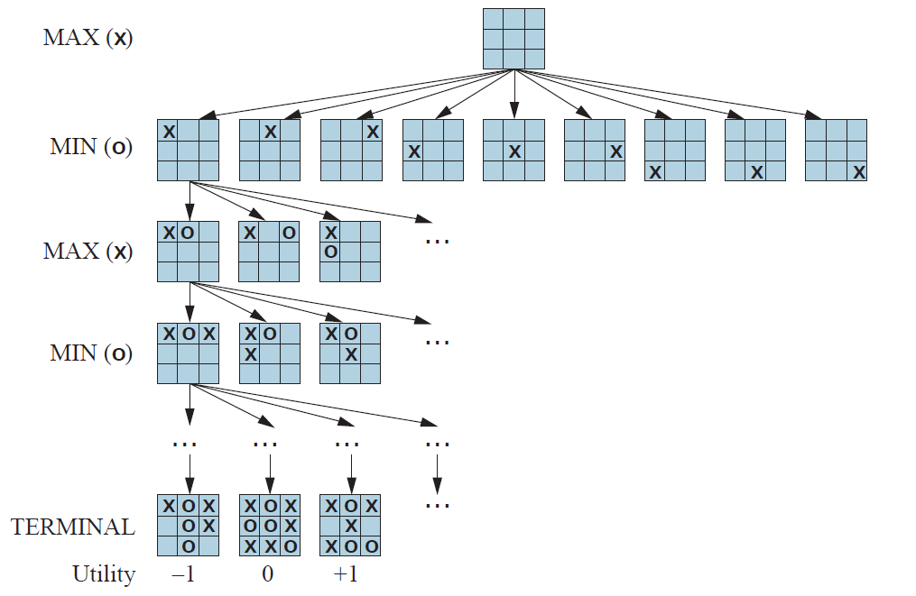
Partial Game Tree for Tic-Tac-Toe
Each level of search nodes in the tree corresponds to all possible board configurations for a particular player MAX or MIN.
Utility values found at the end can be returned to their parent nodes.
Idea: MAX chooses the board with the max utility value, MIN the minimum.
High values are good for MAX, bad for MIN.

Slide 10
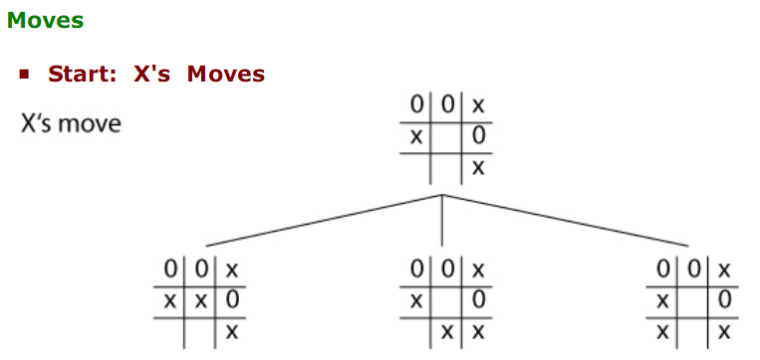
Partial Game Tree for Tic-Tac-Toe

Slide 11
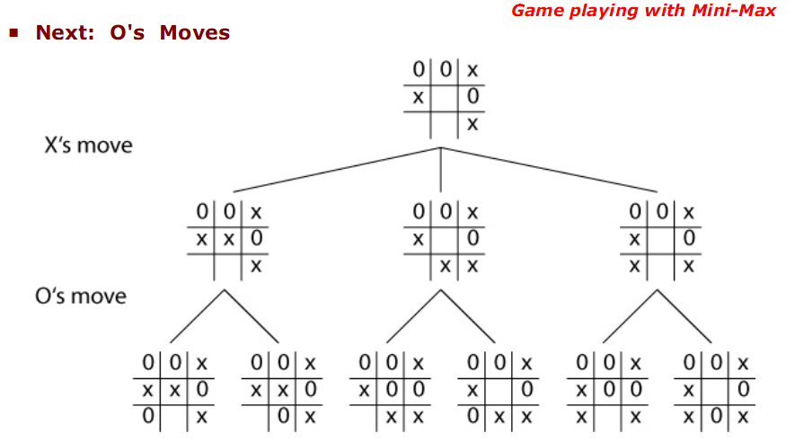
Partial Game Tree for Tic-Tac-Toe

Slide 12
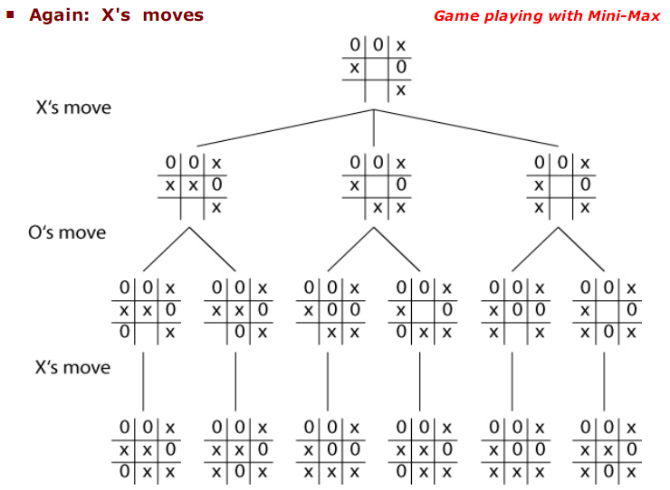


Partial Game Tree for Tic-Tac-Toe

Slide 13
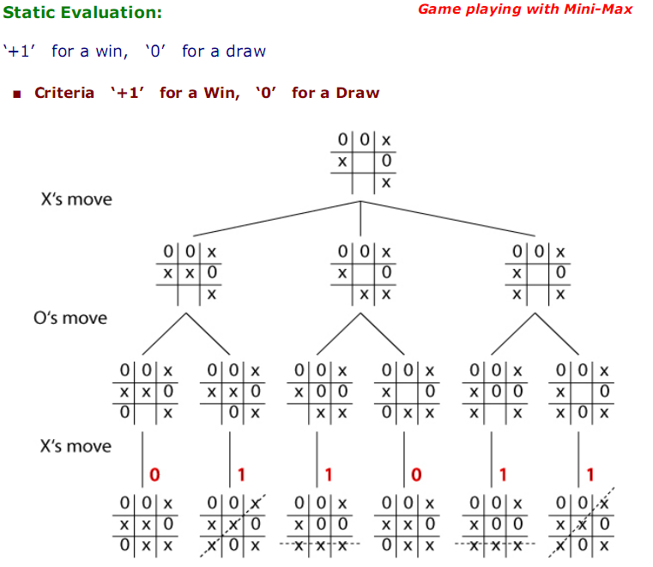




Partial Game Tree for Tic-Tac-Toe

Slide 14
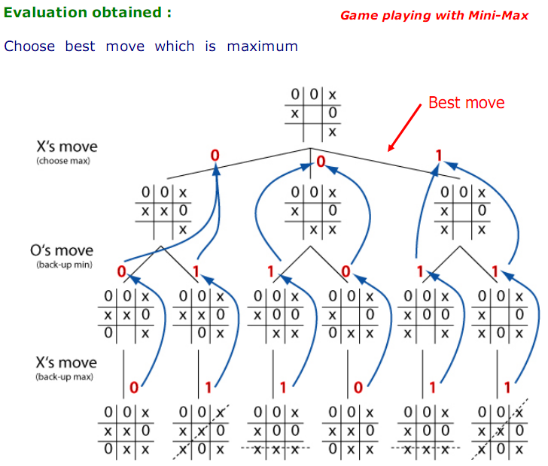
Partial Game Tree for Tic-Tac-Toe
MAX
MIN
MAX

Slide 15
Searching in a two-player game
The search space in game playing is potentially very huge: Need for optimal strategies.
The goal is to find the sequence of moves that will lead to the winning for MAX.
How to find the best strategy for MAX assuming that MIN is an infallible (do not make mistakes) opponent.
Given a game tree, the optimal strategy can be determined by the MINIMAX-VALUE for each node. It returns:
Utility value of n if n is the terminal state.
Maximum of the utility values of all the successor nodes s of n : n is a MAX’s current node.
Minimum of the utility values of the successor node s of n : n is a MIN’s current node.

Slide 16



Minimax Algorithm
Perfect for deterministic, 2-player game
One opponent tries to maximize score (Max)
One opponent tries to minimize score (Min)
Goal: move to position of highest minimax value
Identify best achievable payoff against best play

Slide 17
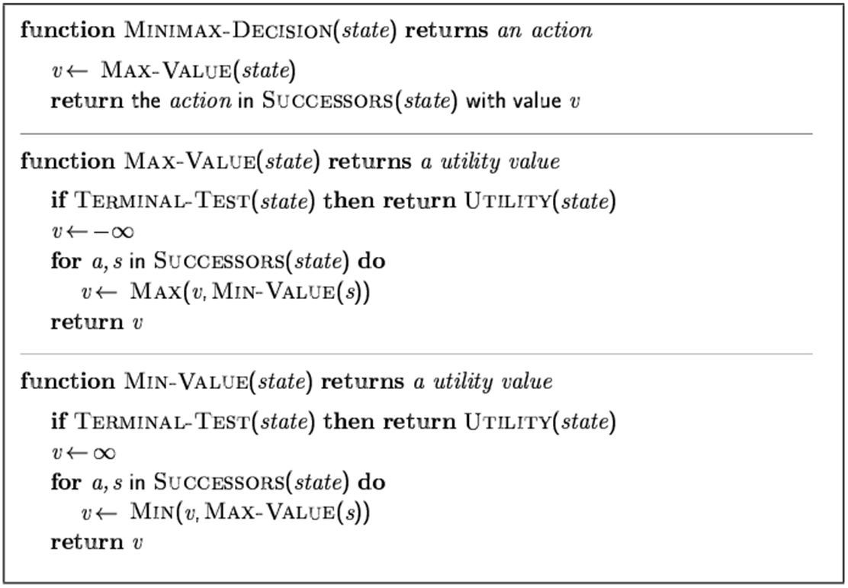
Minimax Algorithm

Slide 18
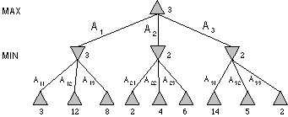
Minimax Algorithm
Max node
Min node
MAX node
MIN node
value computed
by minimax
Utility value

Slide 19
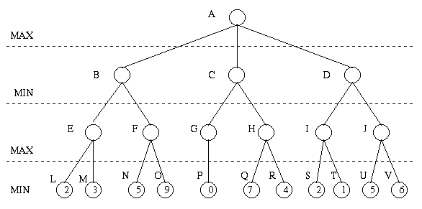


Minimax Algorithm

Slide 20
Minimax Algorithm
3
9
0
7
2
6

Slide 21
Minimax Algorithm
3
0
2
3
9
0
7
2
6

Slide 22
Minimax Algorithm
3
3
0
2
3
9
0
7
2
6

Slide 23

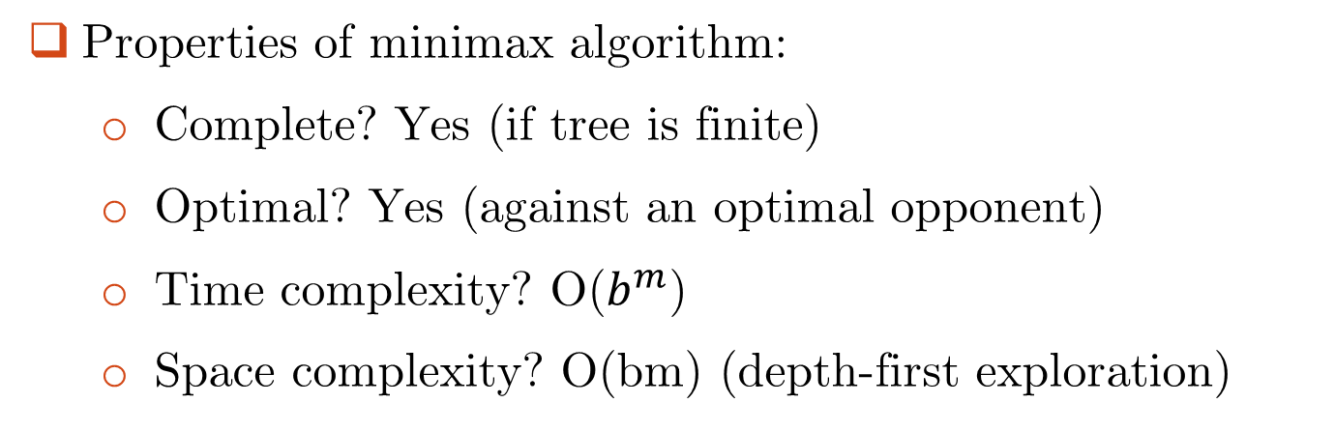

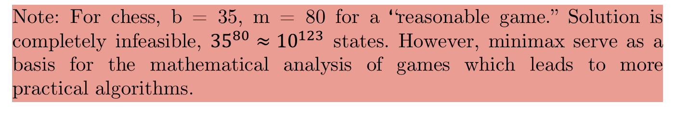
Minimax Algorithm
Properties of minimax algorithm:
  Complete? Yes (if tree is finite)
  Optimal? Yes (against an optimal opponent)
  Time complexity? O($b^{m}$)
  Space complexity? O(bm) (depth-first exploration)
Note: For chess, b = 35, m = 80 for a “reasonable game.” Solution is completely infeasible, ${35}^{80}≈{10}^{123}$ states. However, minimax serve as a basis for the mathematical analysis of games which leads to more practical algorithms.

Slide 24
Minimax Algorithm: Limitations
Limitations
  Not always feasible to traverse entire tree
  Time limitations
Improvements
  Depth-first search improves speed
  Use evaluation function instead of utility
    Evaluation function provides estimate of utility at given position
Notes:
Similar to heuristic function

Slide 25


Minimax Algorithm: Limitations
Problem: Number of games states is exponential to the number of moves.
Solution: Do not examine every node.
Alpha-beta pruning
Alpha = value of best choice found so far at any choice point along the MAX path.
Beta = value of best choice found so far at any choice point along the MIN path.
☺

Slide 26

Alpha-Beta Pruning
“If you have an idea that is surely bad, don't take the time to see how truly awful it is.”
- Pat Winston

Slide 27
Alpha-Beta Pruning
Some branches will never be played by rational players since
they include sub-optimal decisions (for either player).
>=2
We don’t need to compute the value at this node.
No matter what it is, it can’t affect the value of the root node.
=2
<=1
2
7
1
?

Slide 28
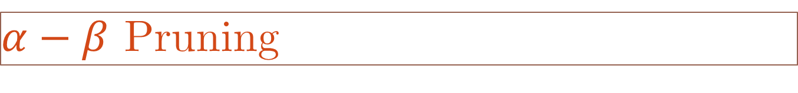


$α−β$ Pruning
Principle
If a move is determined worse than another move already examined, then further examination deemed pointless.

Slide 29
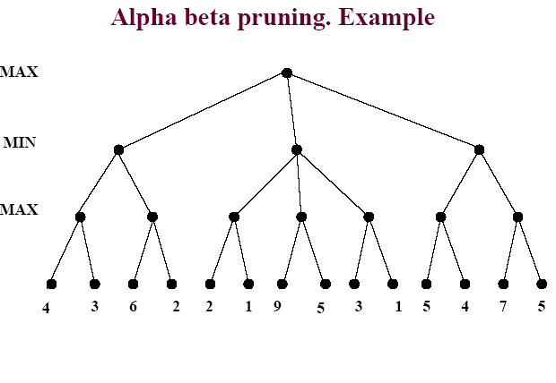
$α−β$ Pruning

Slide 30
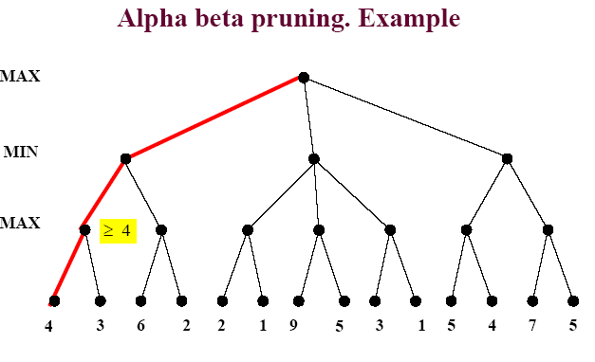
$α−β$ Pruning

Slide 31
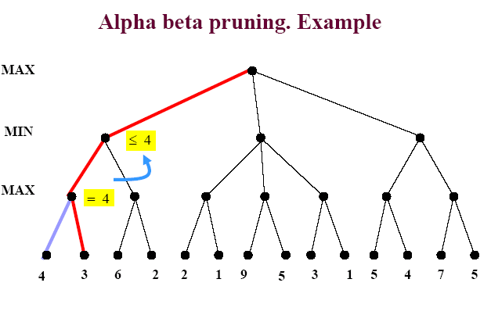
$α−β$ Pruning

Slide 32
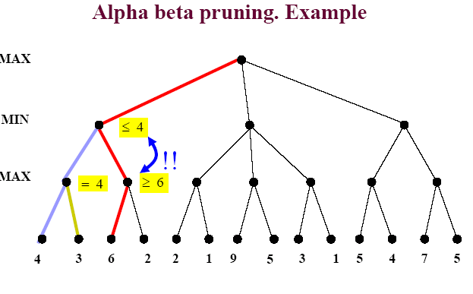
$α−β$ Pruning

Slide 33
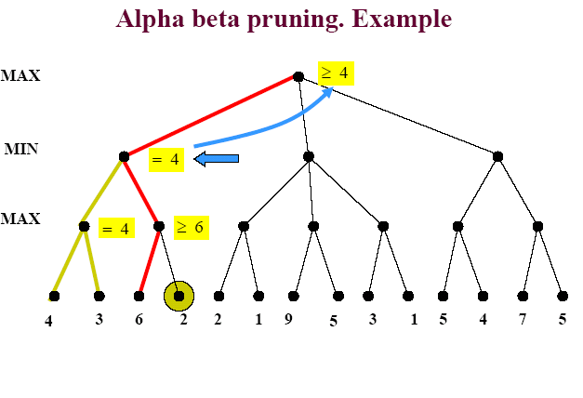
$α−β$ Pruning

Slide 34
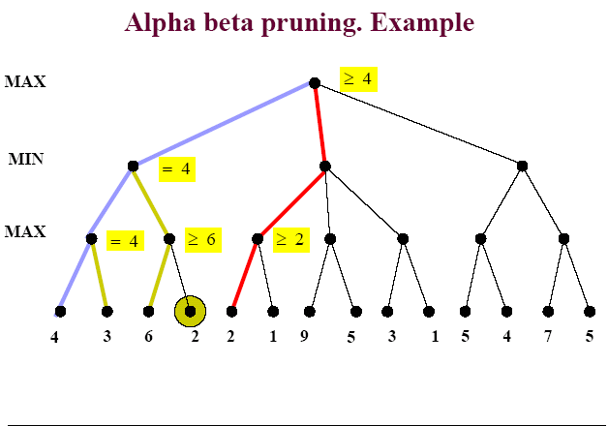
$α−β$ Pruning

Slide 35
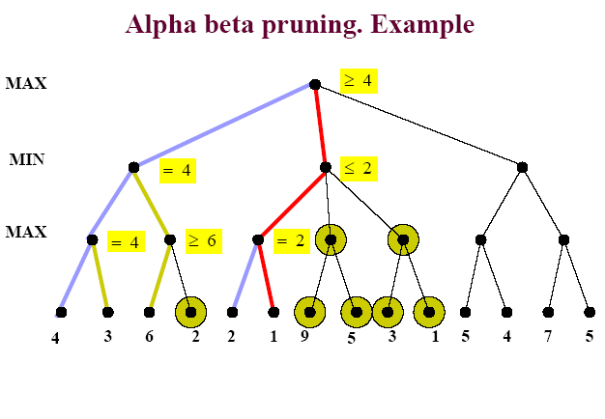
$α−β$ Pruning

Slide 36
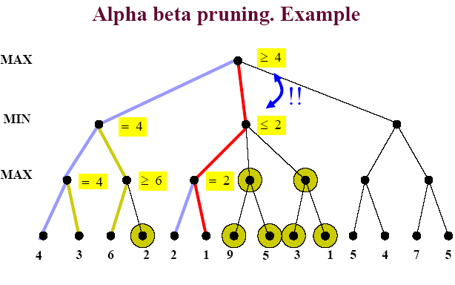
$α−β$ Pruning

Slide 37
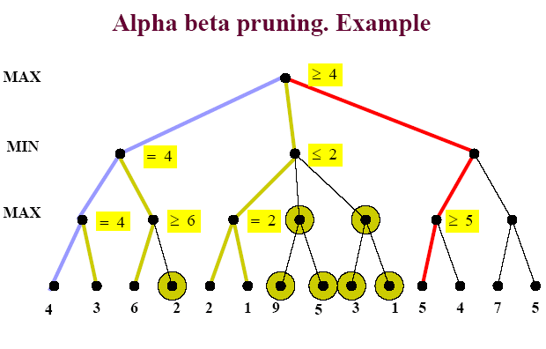
$α−β$ Pruning

Slide 38
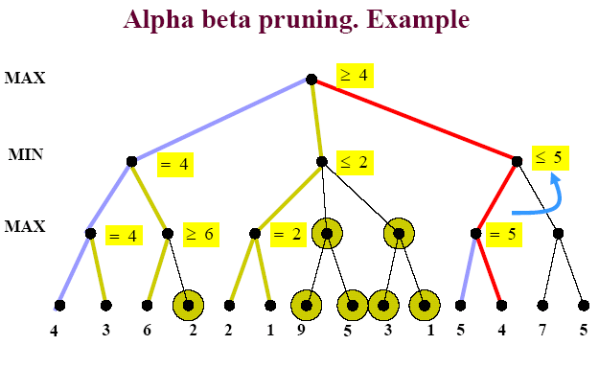
$α−β$ Pruning

Slide 39
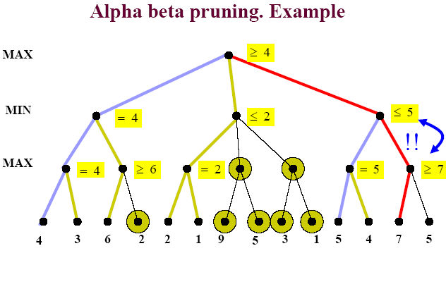
$α−β$ Pruning

Slide 40
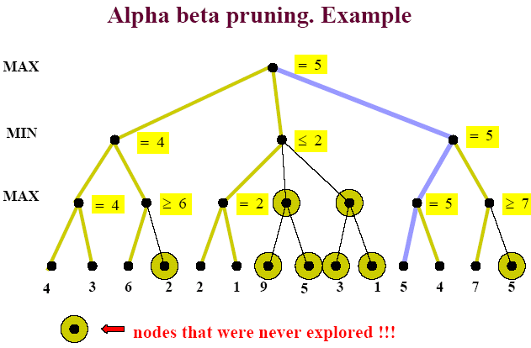
$α−β$ Pruning

Slide 41
$α−β$ Pruning
Rules of Thumb
  α is the highest max found so far
  β is the lowest min value found so far
  If Min is on top Alpha prune
  If Max is on top Beta prune
  You will only have alpha prune at Min level
  You will only have beta prune at Max level

Slide 42
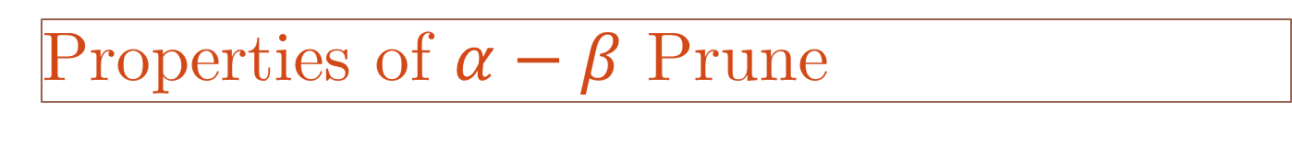
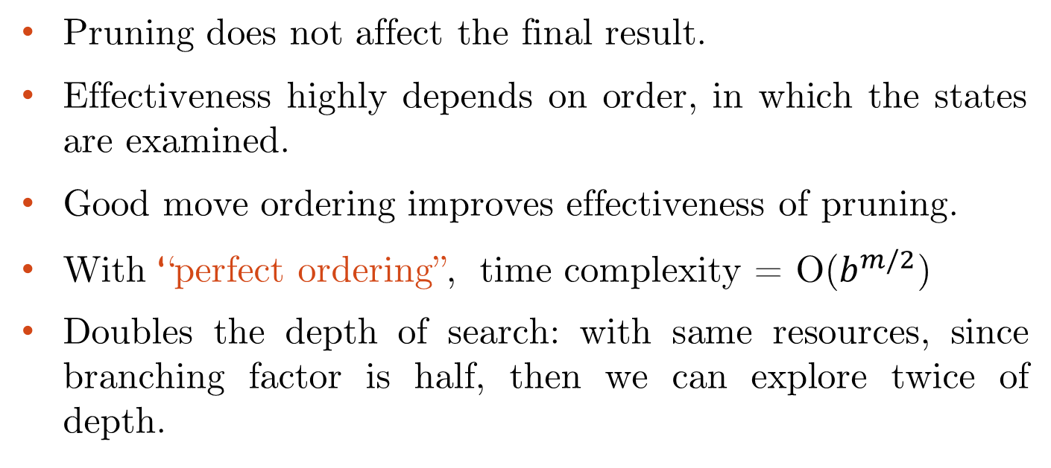
Properties of $α−β$ Prune
Pruning does not affect the final result.
Effectiveness highly depends on order, in which the states are examined.
Good move ordering improves effectiveness of pruning.
With “perfect ordering”, time complexity = O($b^{m/2}$)
Doubles the depth of search: with same resources, since branching factor is half, then we can explore twice of depth.

Slide 43
Alpha-Beta Pruning Algorithm
Traverse the search tree in depth-first order.
At each Max node n, alpha(n) = maximum value found so far
  Start with - infinity and only increase.
  Increases if a child of n returns a value greater than current alpha.
  Serve as a tentative lower bound of the final pay-off.
At each Min node n, beta(n) = minimum value found so far
  Start with infinity and only decrease.
  Decreases if a child of n returns a value less than current beta.
  Serve as a tentative upper bound of the final pay-off.
beta(n) for MAX node n: smallest beta value of its MIN ancestors.
alpha(n) for MIN node n: greatest alpha value of its MAX ancestors.

Slide 44
General description of α-β pruning algorithm
Alpha-Beta Pruning Algorithm
Carry alpha and beta values down during search
  alpha can be changed only at MAX nodes
  beta can be changed only at MIN nodes
  Pruning occurs whenever alpha >= beta
Alpha cutoff:
  Given a Max node n, cutoff the search below n (i.e., don't generate any more of n's children) if alpha(n) >= beta(n)
  (alpha increases and passes beta from below)
Beta cutoff:
  Given a Min node n, cutoff the search below n (i.e., don't generate any more of n's children) if beta(n) <= alpha(n)
  (beta decreases and passes alpha from above)

Slide 45
Alpha-Beta Pruning Algorithm
function ALPHA-BETA-SEARCH(state) returns an action
inputs: state, current state in game
v← MAX-VALUE(state, - ∞ , +∞)
return the action in SUCCESSORS(state) with value v
function MAX-value (n, alpha, beta) return utility value
if n is a leaf node then return f(n);
for each child n’ of n do
alpha :=max{alpha, MIN-value(n’, alpha, beta)};
if alpha >= beta then return beta /* pruning */
end{do}
return alpha
function MIN-value (n, alpha, beta) return utility value
if n is a leaf node then return f(n);
for each child n’ of n do
beta :=min{beta, MAX-value(n’, alpha, beta)};
if beta <= alpha then return alpha /* pruning */
end{do}
return beta

Slide 46
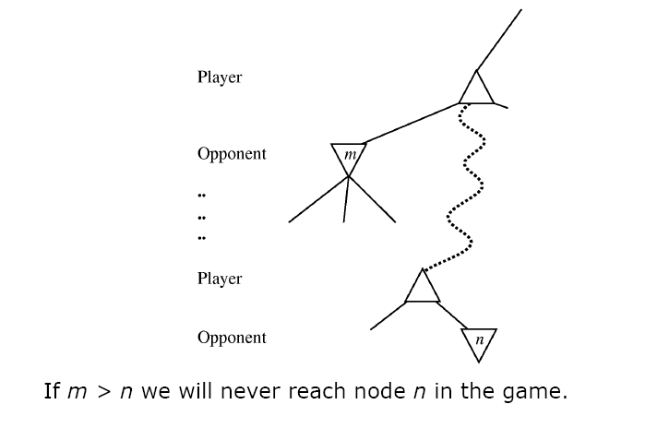
Alpha-Beta Pruning Algorithm
In another way:

Slide 47
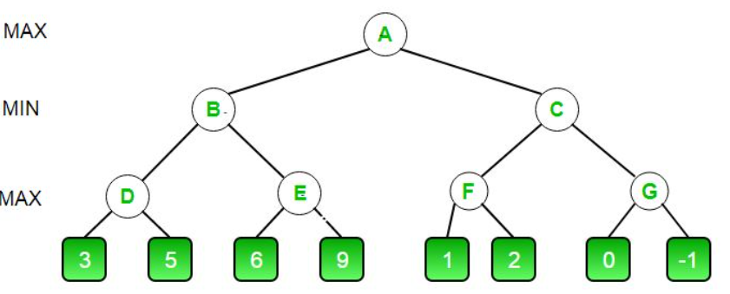






Alpha-Beta Pruning: Example

Slide 48
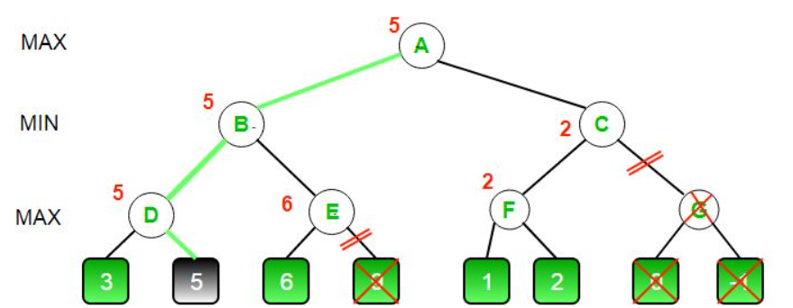
Alpha-Beta Pruning: Example

Slide 49
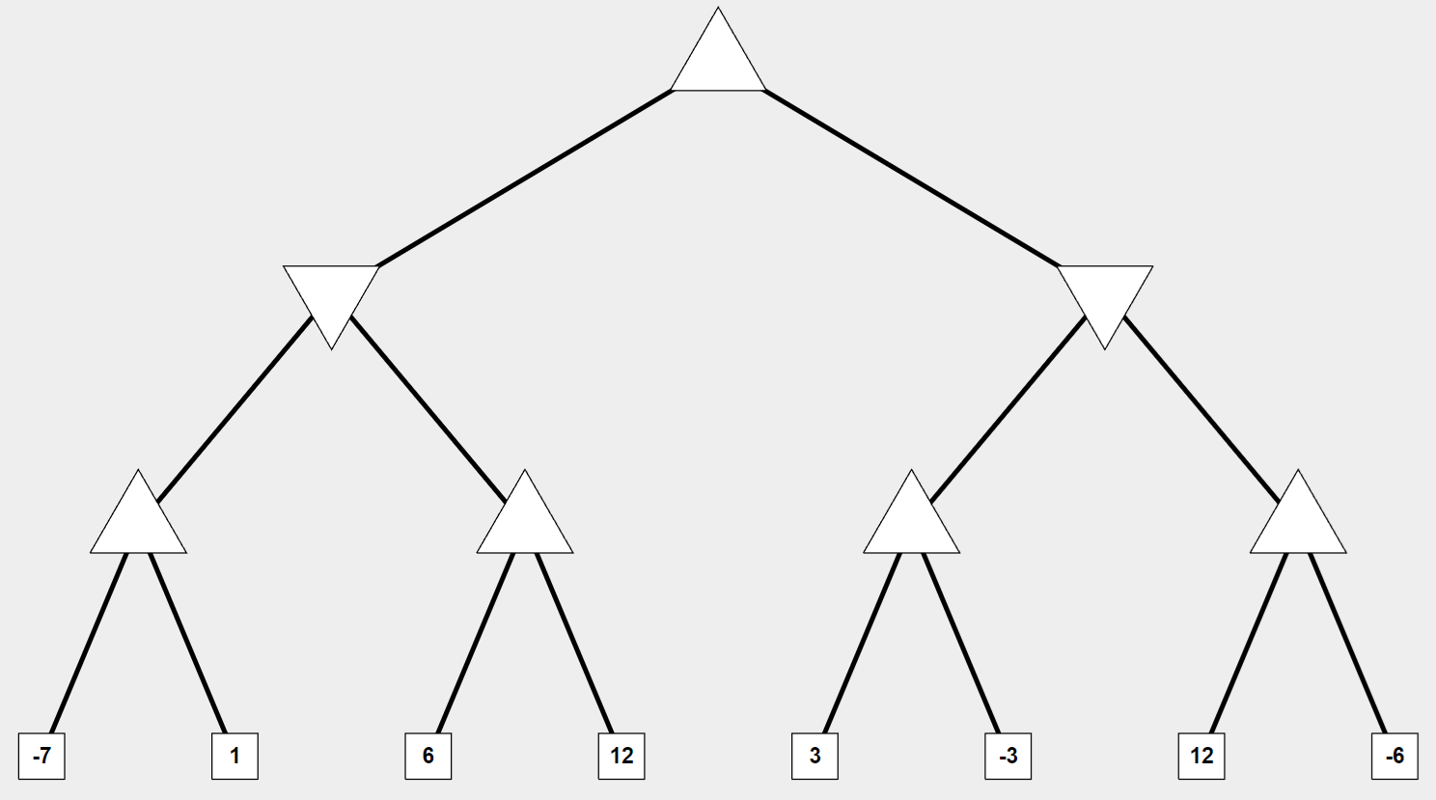
Alpha-Beta Pruning: Exercise

Slide 50
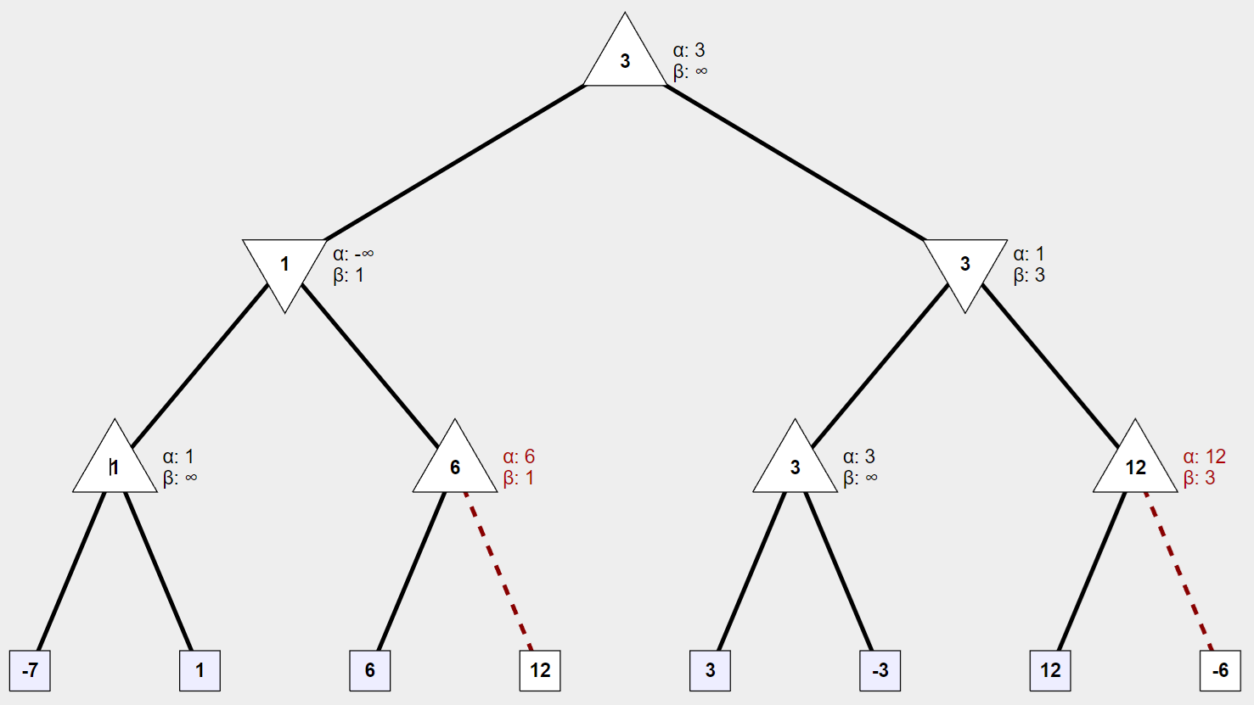
Alpha-Beta Pruning: Exercise

Slide 51
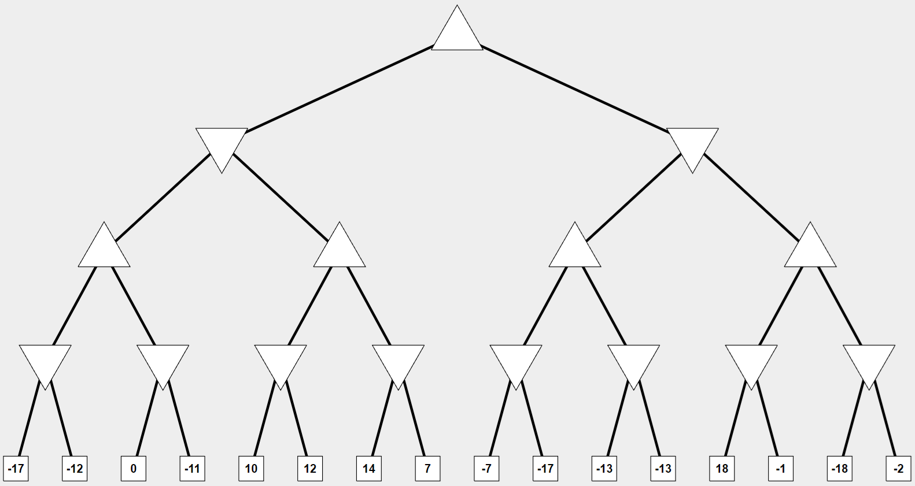
Alpha-Beta Pruning: Practice

Slide 52
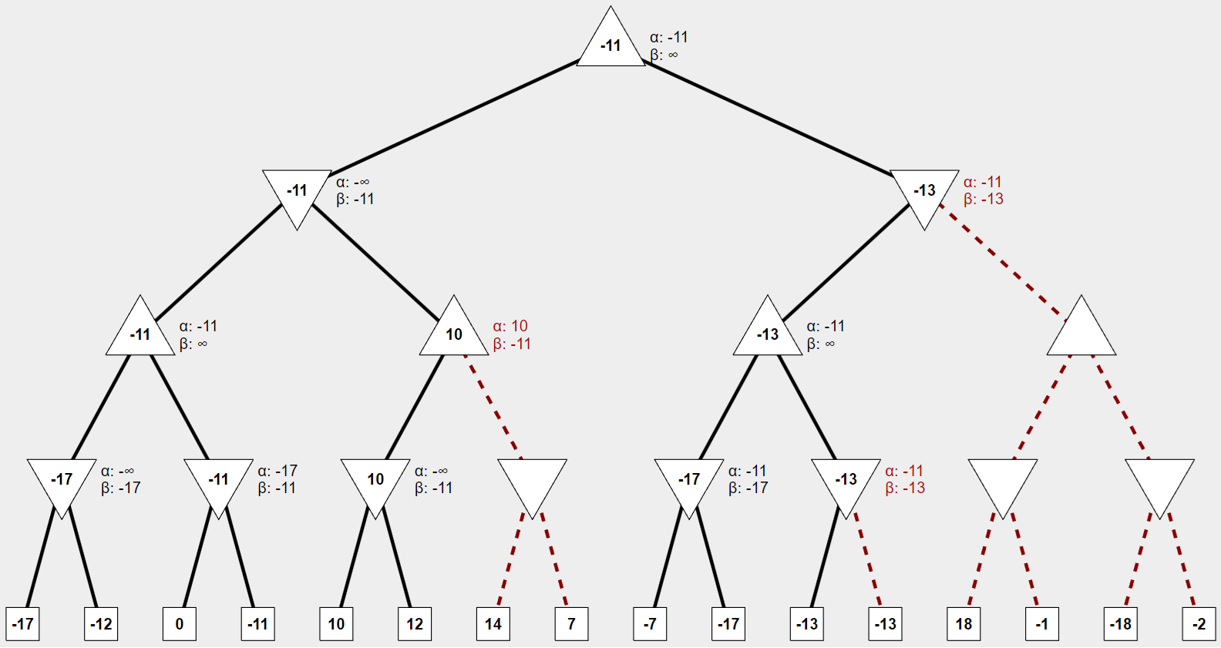
Alpha-Beta Pruning: Practice
https://pascscha.ch/info2/abTreePractice/

Slide 53
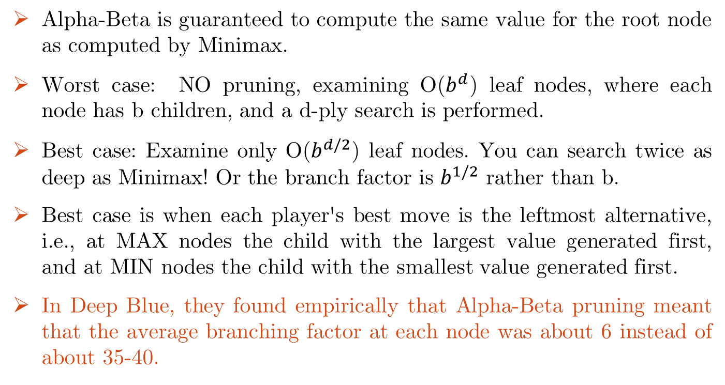
Evaluating Alpha-Beta Algorithm
Alpha-Beta is guaranteed to compute the same value for the root node as computed by Minimax.
Worst case: NO pruning, examining O($b^{d}$) leaf nodes, where each node has b children, and a d-ply search is performed.
Best case: Examine only O($b^{d/2}$) leaf nodes. You can search twice as deep as Minimax! Or the branch factor is $b^{1/2}$ rather than b.
Best case is when each player's best move is the leftmost alternative, i.e., at MAX nodes the child with the largest value generated first, and at MIN nodes the child with the smallest value generated first.
In Deep Blue, they found empirically that Alpha-Beta pruning meant that the average branching factor at each node was about 6 instead of about 35-40.

Slide 54
Evaluation Functions
Evaluation function:
  Performed at search cutoff point
  Must have same terminal/goal states as utility function
  Tradeoff between accuracy and time → reasonable complexity
  Accurate
    Performance of game-playing system dependent on accuracy/goodness of evaluation
    Evaluation of nonterminal states strongly correlated with actual chances of winning

Slide 55
Evaluation Functions
For chess, typically linear weighted sum of features.
Eval(s) = w1 f1(s) + w2 f2(s) + … + wn fn(s)
e.g., w1 = 9 with
f1(s) = (number of white queens) – (number of black queens), etc.
Key challenge – find a good evaluation function:
Isolated pawns are bad.
How well protected is your king?
How much maneuverability to you have?
Do you control the center of the board?
Strategies change as the game proceeds

Slide 56
Reading
Chapter 06 of the textbook

